Slide 1
Energy Efficiency Indicators
Norway, indicator workshop 29.8.2023
Lea Gynther

Slide 2
Table of Contents
Energy Efficiency Indicator Studies in Finland
The Good, The Bad and The Ugly
Way Forward?

Slide 3
Energy Efficiency Indicator Studies in Finland

Slide 4
Use of Energy Efficiency Indictors in Finland
Energy efficiency indicators do not have a strong designated role in Finland, e.g., no targets are set for their levels.
Summary of views: aggregate indicators such as energy intensities should be interpreted with extreme care. Lower-level indicators (e.g. diffusion indicators for certain technologies or specific consumption) are generally much better to monitor progress.
Energy Efficiency Trends and Drivers, a set of indicators has been produced annually for almost twenty years by Motiva for the national authorities (see next slides).
A series of sectoral energy efficiency indicator reports has been conducted to increase understanding of indicators and their usability and to respond to questions raised by international comparisons (see next slides).

Slide 5
Energy Efficiency Trends and Drivers
Primary and final energy intensities, intensity of electricity use / total and sectoral indicators, industrial sub-sectors
Primary and final energy per capita
Losses-%, electricity and district heat
Share of CHP production (power+DH)
Power plant efficiencies (CHP, electricity and heat only)
Specific consumption of steel and pulp&paper
Specific consumption of cars, buses, rail
Specific consumption of trucks and freight rail
CO2 emissions of new passenger cars
Average specific consumption of new cars
New cars by engine capacity
Passenger cars per household
Normalized specific space heat consumption per permanently occupied dwelling
Normalized specific consumption of DH in domestic and service sector buildings
Average floor area by type of dwelling and occupancy rate of dwellings
Long term average degree days and annual averages
Electricity consumption per free-time residence
Population and number of households
Average household income
Electricity consumption per employee in the services sector
Surface area of service sector buildings
Unit consumption of heat per m2 in services
Unit consumption of electricity per m2 in services
A range from good to bad indicators. We need to know the levels of all of them.

Slide 6
Indicator Studies in Finland
Indicator studies (reports in English):
Report on data centers (2022), Motiva Oy
Commerce sector (2021); Motiva Oy and Granlund Oy
Metals production industry (2020); Motiva Oy and data from Wood MacKenzie
Pulp and paper industry (2019); VTT and simulations by Fisher International Ltd
Report on country comparisons, e.g., decomposition (2018); VTT

Slide 7
Study Implementation
Financed by the Finnish Energy Authority with some sector contributions (pulp and paper)
Steering group consisted of industry associations and major companies to ensure industry insights:
Commerce sector: Kesko (K-Group), Lidl, S-Group, Stockmann
Basic metals: Boliden, Outokumpu, Ovako, SSAB Finland
Pulp and paper: Metsä Group, Stora Enso, UPM
Data centers: Finnish Data Center Association (FDCA); forum reps duplicate as data center operators and designers
Objectives of the first three studies above were to get insights at the operator/site level on the actual energy efficiency and to find factors which may distort comparisons. Study in the data center sector concentrated on implementation of the recast Energy Efficiency Directive.

Slide 8
The Good, The Bad and The Ugly

Slide 9

Objectives
What is the motivation for considering energy efficiency indicators:
  Identifying driving forces behind observed trends?
  Setting targets and monitoring progress at aggregate level?
  Tracking of the policy impact?
  Benchmarking within the country or with other countries?
  Level of indicators:
  Monitoring at the national, regional, local or operator level?

Slide 10
What Makes a Good Indictor?
It should be ensured that the indicators actually measure either energy efficiency or monitor drivers for energy efficiency, not something else like productivity.
  Preferably energy efficiency indicators measuring input of energy per some kind of output, e.g. energy per tonne of product or per heated floor area in occupied dwellings.
Good data quality (reliability of data, no data breaks, no changes in definitions over time etc.).
System boundaries should be considered.
  Are you “exporting” a lot of energy inputs embedded in the product (e.g. in pulp) but another country re-processes it into higher value products (e.g. glossy paper)
  Do the sub-systems remain the same within the system boundary over time?

Slide 11

Problematic Indicators
Energy intensity (energy per value added): Does not monitor energy efficiency but rather productivity etc. Also energy per production index is at least partly related to economic considerations, not only to physical production.
Energy consumption per employee: No clear link exists between these two and pursuit for cost-effectiveness in businesses drives the indicator upwards.
Specific electricity consumption (e.g. per floor area or product volume): Electricity consumption is growing as society electrifies (stronger focus on emission reductions) or heat pumps are used to capture waste heat (in whose energy balance are they?).
Indicators should not necessarily be applied in the same way for all installation sizes (e.g. in the commercial sector specific consumption should be calculated separately for different size categories).
Notes:
The volume index of industrial output describes the change in the monthly volume of industrial output at fixed prices. The purpose of the statistics is to provide fast and reliable information on the cyclical development in manufacturing at a detailed industry level.
For turnover data, the volume index utilises total data. The data suppliers selected to the sample are inquired monthly about the production volumes of the commodities produced by the establishment or legal unit or alternatively, the value of total output, the value of the produced industrial services and the commercial trading margin. With respect to enterprises with fewer than 50 employees, Statistics Finland's own data collection is supplemented with data obtained from the Tax Administration's self-assessed tax data (previously periodic tax return data).

Slide 12
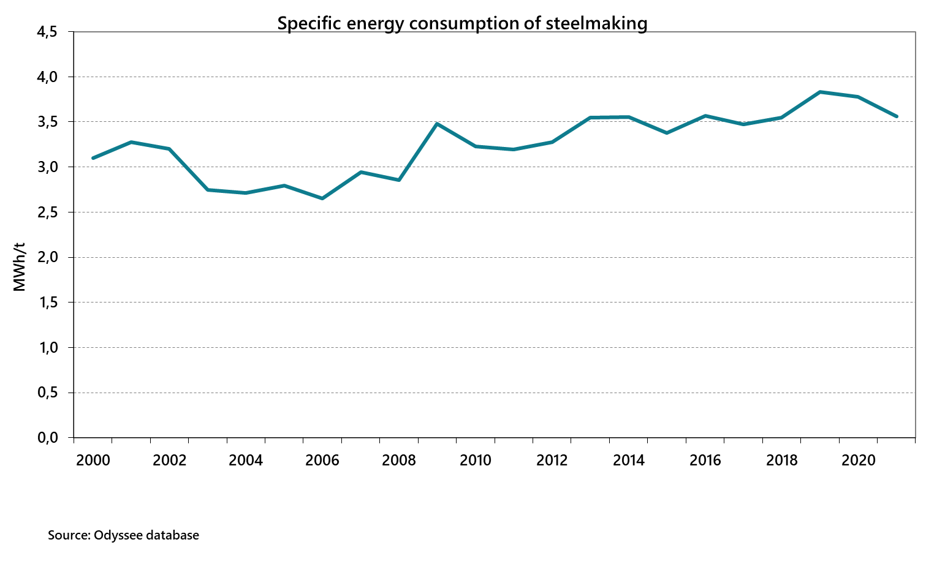
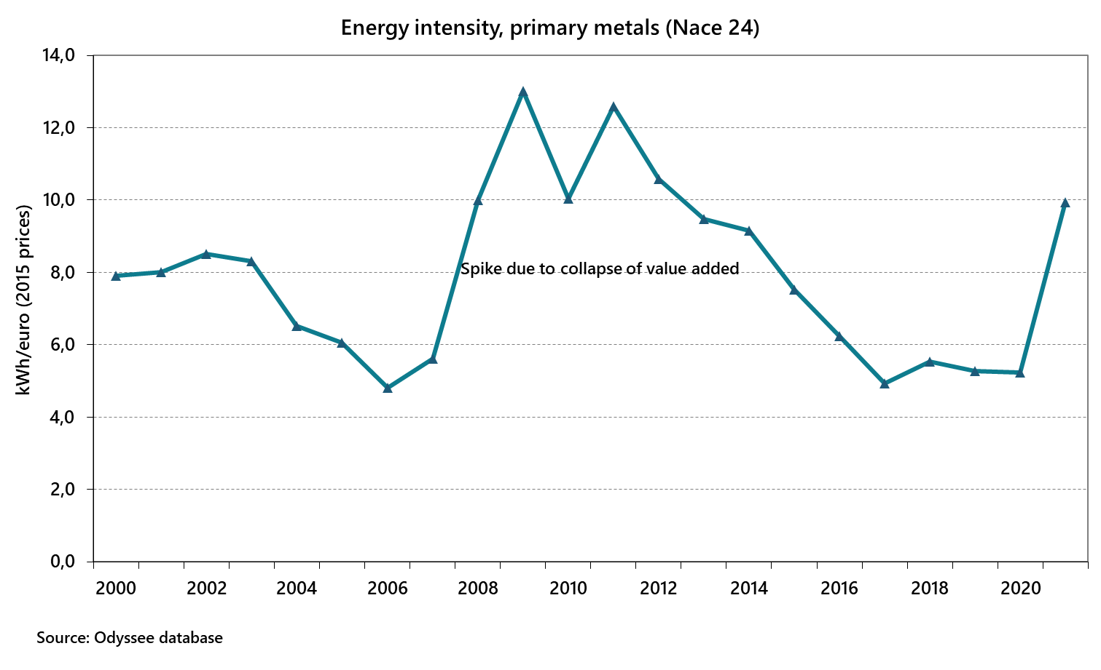
Metal Industry Indicators, Finland
Note: Figures have partly different definitions.

Slide 13

Questionable Use of Indicators
Indicators are at their best in monitoring progress within one country. Finding good indicators for country comparisons is difficult (normalization needs, challenging analytical boundaries, data quality issues).
Highly aggregated indicators:
Availability of data (usually based on basic statistics)
Omit important considerations such as industry structure (outsourcing of sub-processes), production methods (e.g. electric or oxygen steelmaking), raw materials used (virgin/recycled), product mix (bulk/specialized), operation conditions etc.

Slide 14
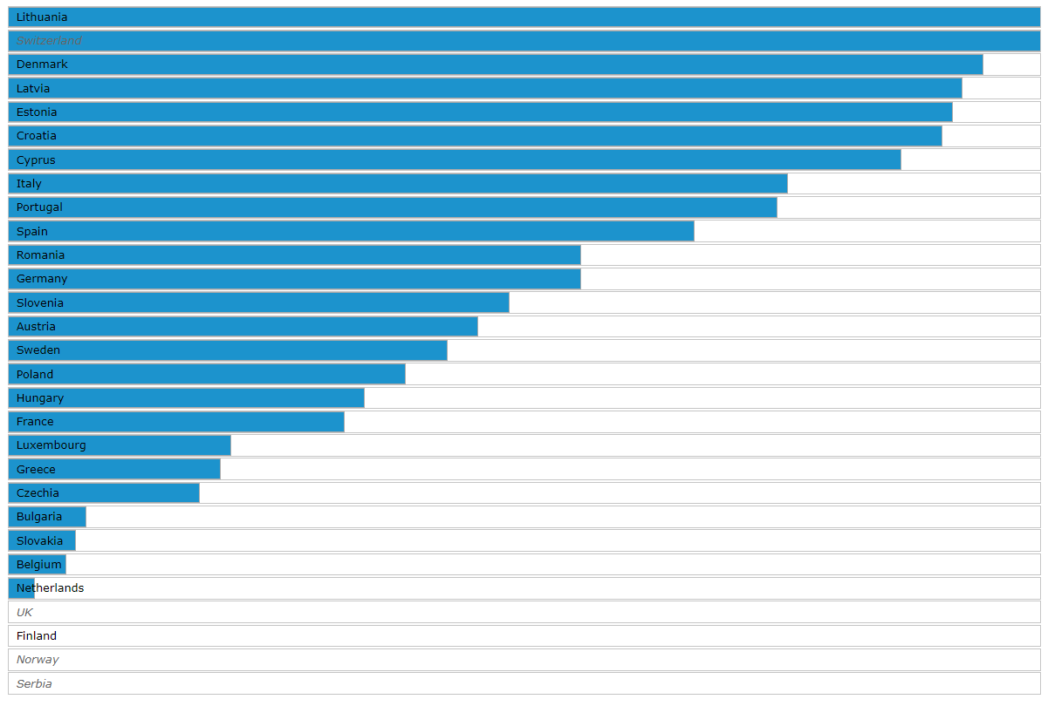
Odyssee-Mure Scoreboard
Industry: Energy efficiency level
(calculated relating consumption to
value added except physical quantity
for pulp&paper in Finland and Sweden)
Really?

Slide 15
Other Methodological Considerations
Climate change corrections:
National HDD vs. Eurostat data
HDD does not correct weather variations perfectly in “extreme” years
Other valid sustainability considerations may affect energy consumption and energy efficiency, such as aim to use raw materials efficiently and to reduce generation of waste.
Decomposition is a potentially interesting tool for monitoring the reasons behind observed changes in energy consumption. However, attention should be paid, e.g., to the indicators used and coherent datasets. Results published by different institutions vary even when same input data is used.

Slide 16
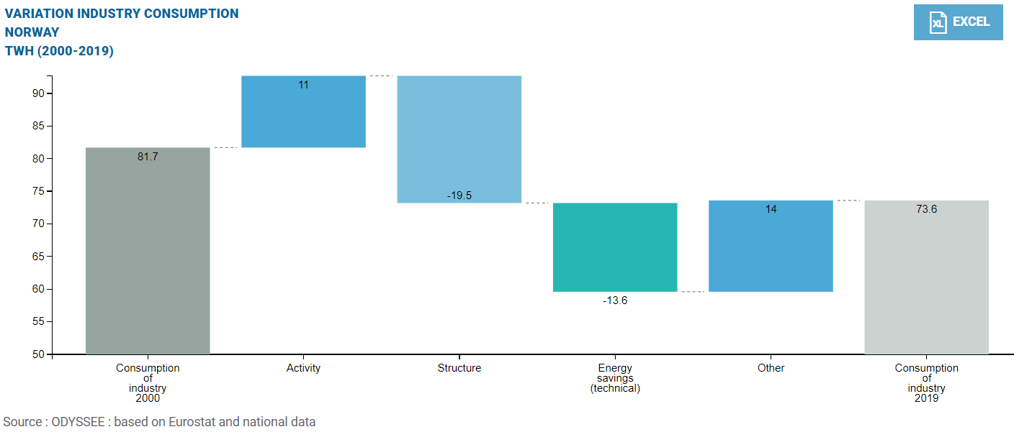
ODYSSEE Decomposition, Industry, Norway

Slide 17
Way Forward?

Slide 18
Further Reading
IEA: Roadmap on Demand-side data and energy efficiency indicators (Feb 2023)
Energy Efficiency Indicators: Essentials for Policy Making (2014)
EU ODYSSEE-Mure Project

Slide 19
Elements to Consider
Indicators
Data sources and management
Responsibilities
Resources
Analysis
Dissemination
Continuous improvement cycle

Slide 20
Thank you!
Lea.Gynther@motiva.fi

