Slide 1
Værrelaterte feil SUBTITLE
Volker Hoffmann <volker.hoffmann@sintef.no>
Energytics Avslutningsseminar, 10 June 2020
Notes:
Bildet illustrerer:
· bredden i SINTEFs ekspertise, fra havrom til verdensrom.
· hvilke områder og bransjer vi jobber innen for å realisere visjonen Teknologi for et bedre samfunn.
Bildestilen er basert på stikkordene fremtidsrettet, teknologi og norsk natur (naturressurser). SINTEFs visuelle univers er utviklet for SINTEF av Headspin Productions AS.

Slide 2
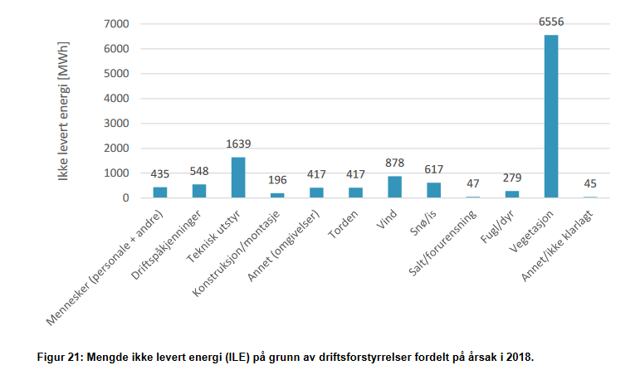
Context
~2000 MWh ILE (2018)
pga Værrelaterte Utfordringer
http://publikasjoner.nve.no/rapport/2019/rapport2019_27.pdf

Slide 3
Exploratory Data Analysis
Værrelaterte
Feil
Explaining Outages
Predicting Outages
Towards Operations

Slide 4
Exploratory Data Analysis
Værrelaterte
Feil
Explaining Outages
Predicting Outages
Towards Operations

Slide 5
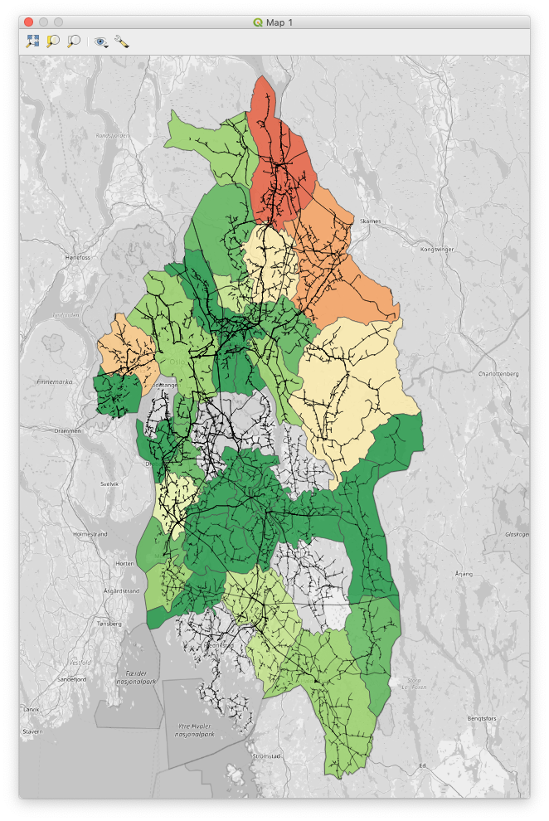
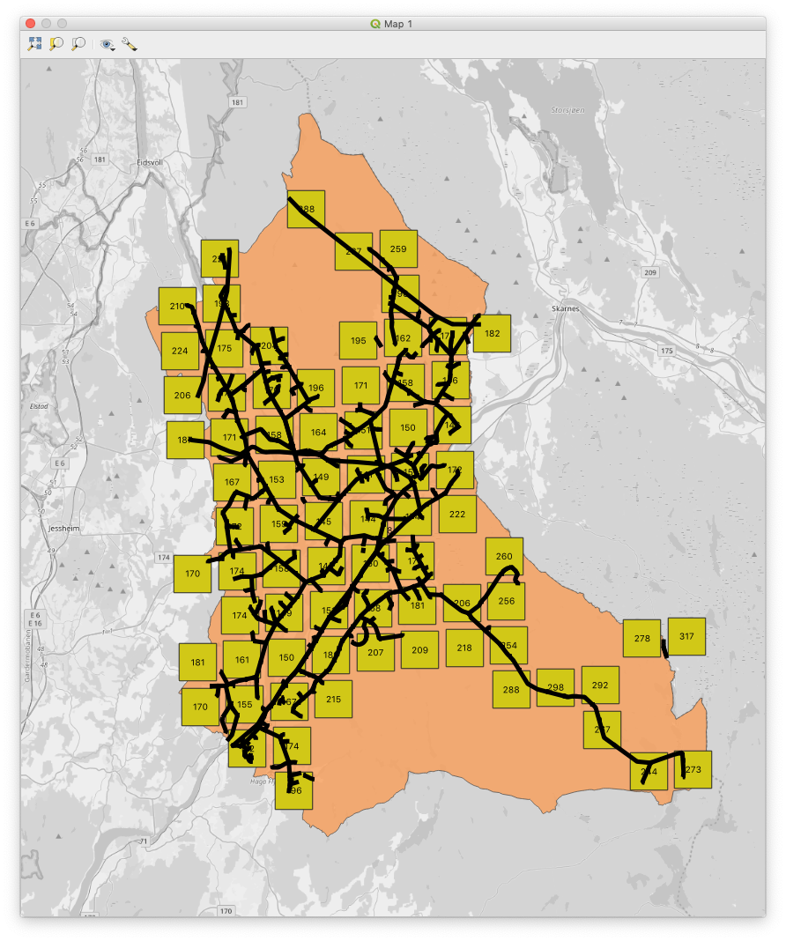
Exploratory Data Analysis | Explaining Outages | Predicting Outages | Towards Operations

Slide 6
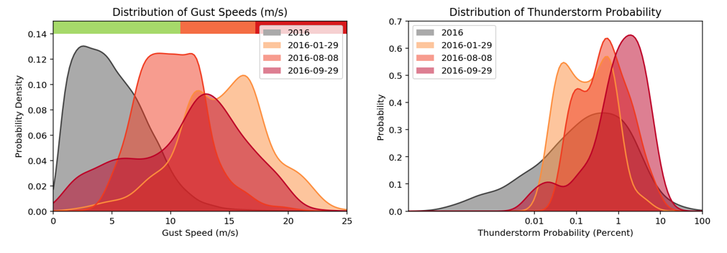
Exploratory Data Analysis | Explaining Outages | Predicting Outages | Towards Operations

Slide 7
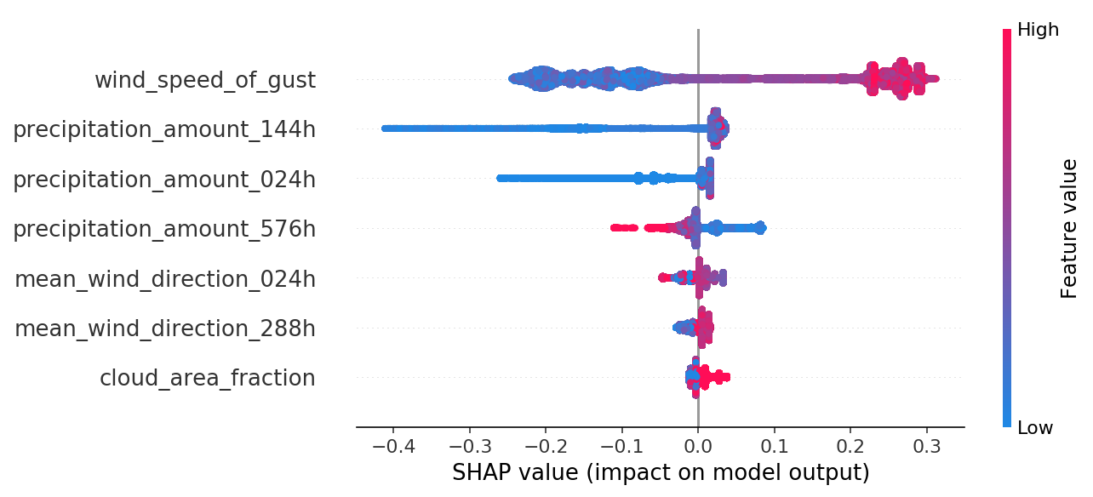
Exploratory Data Analysis | Explaining Outages | Predicting Outages | Towards Operations

Slide 8
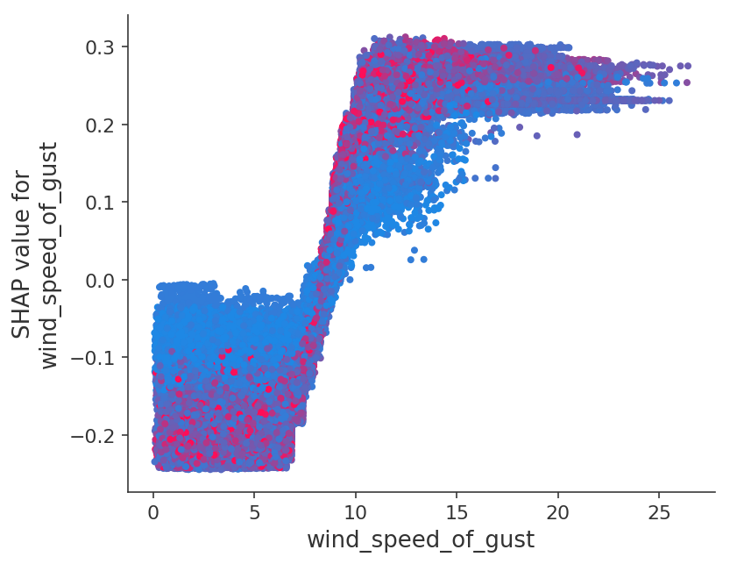
Exploratory Data Analysis | Explaining Outages | Predicting Outages | Towards Operations

Slide 9
Exploratory Data Analysis
Værrelaterte
Feil
Explaining Outages
Predicting Outages
Towards Operations

Slide 10
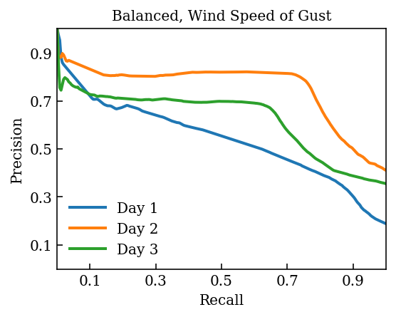
Exploratory Data Analysis | Explaining Outages | Predicting Outages | Towards Operations

Slide 11
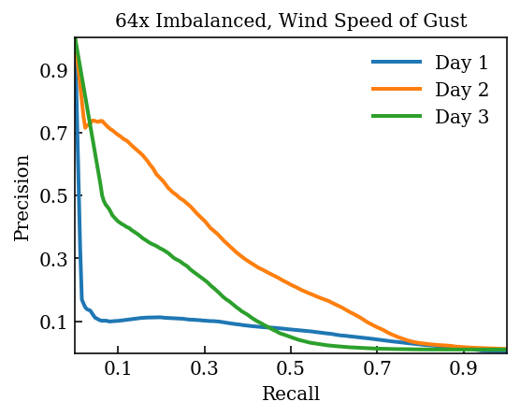
Exploratory Data Analysis | Explaining Outages | Predicting Outages | Towards Operations

Slide 12
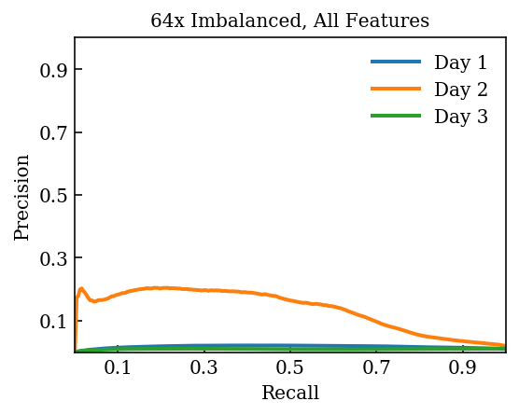
Exploratory Data Analysis | Explaining Outages | Predicting Outages | Towards Operations

Slide 13
Exploratory Data Analysis
Værrelaterte
Feil
Explaining Outages
Predicting Outages
Towards Operations

Slide 14
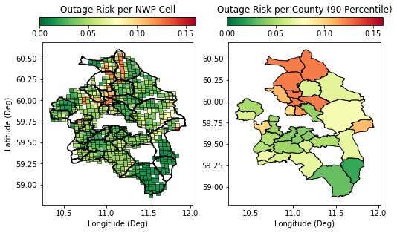
Exploratory Data Analysis | Explaining Outages | Predicting Outages | Towards Operations

Slide 15
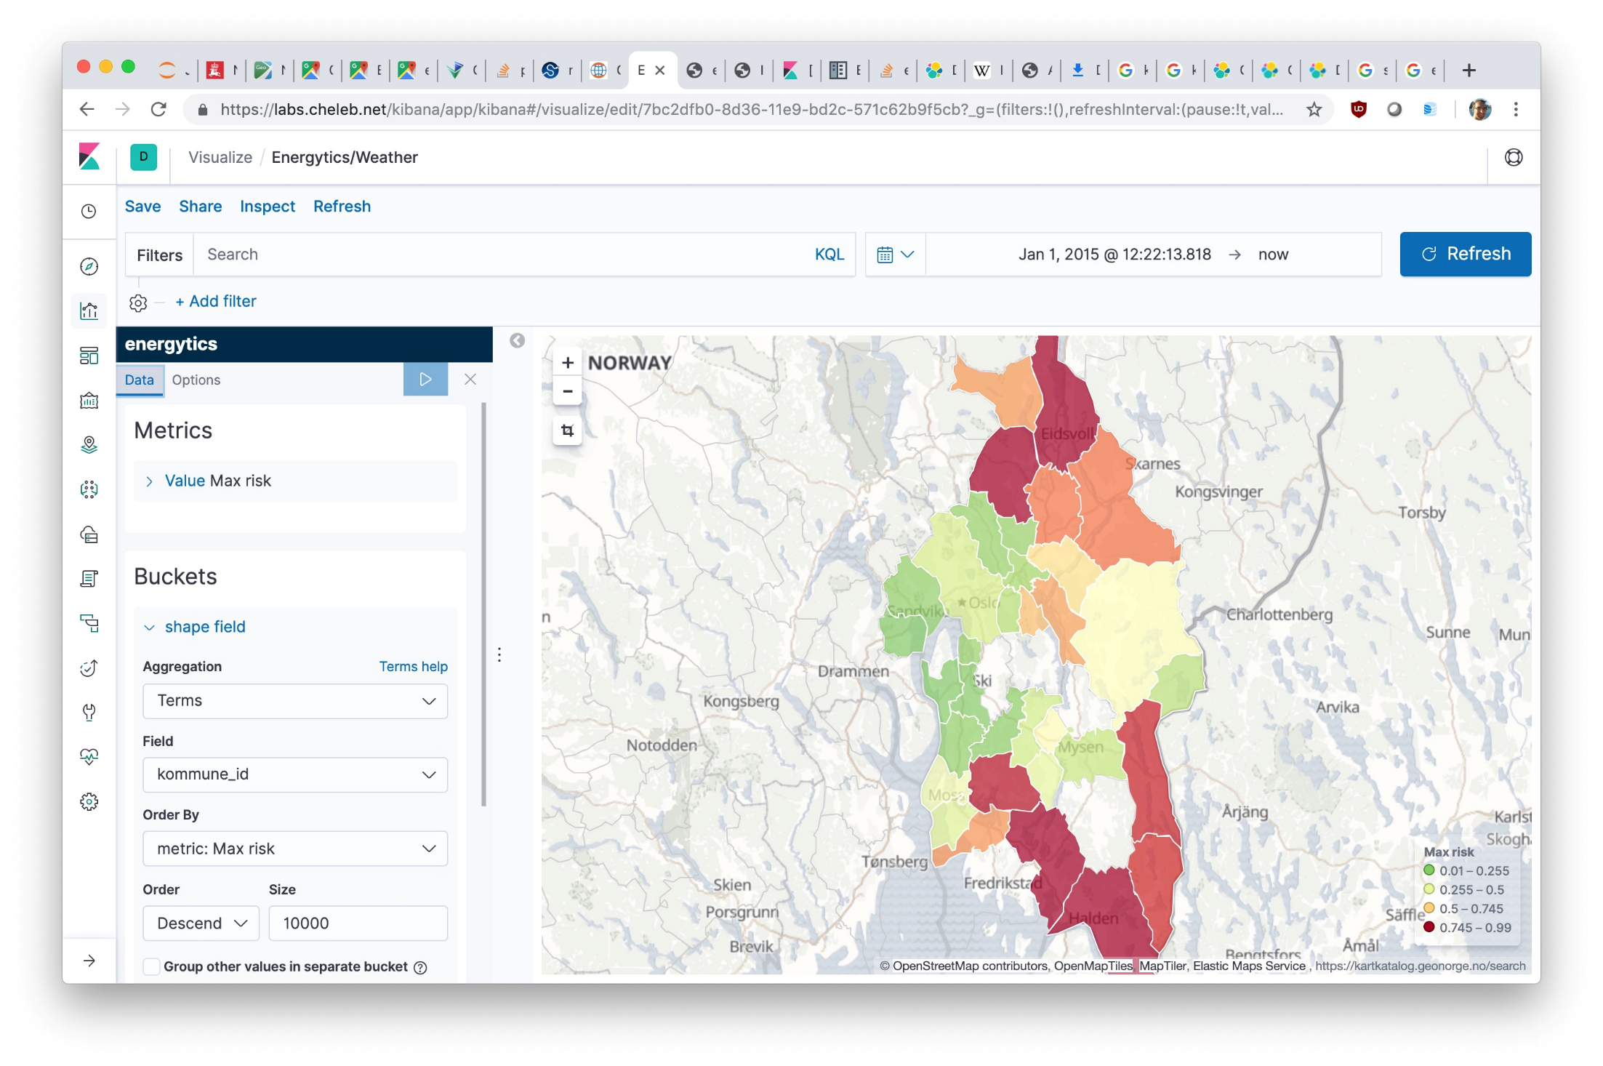
Exploratory Data Analysis | Explaining Outages | Predicting Outages | Towards Operations

Slide 16
Most important variable ~ Wind Speed of Gust
Værrelaterte
Feil
Threshold Value ~ 10 m/s
Models need to improve for operational deployment
Outage logs are too coarse

